Slide 1

ORDER MANAGEMENT SYSTEM
BY
Hrithik Jain-22
Vashesh Jogani-24
Tushar Malankar-31
Supervisor-Prof.Bhushan Prof.Bharati Prof.Meenu

Slide 2


Slide 3

E-commerce system has massively replaced the physical shopping especially for electronic goods. Therefore, we have created our mini project to stimulate the initial aspects of an e-commerce engine starting with user creating an account and ending with checkout and payment.

Slide 4

AIM

Slide 5

The first thing that comes to your mind when you think of order management system is Amazon. Therefore, we decided to model our project on a mini version of Amazon, trying to incorporate some of its features including registration, purchasing items, placing orders, payment, etc.

Slide 6

Literature Review

Slide 7

Amazon is the undisputed world
leader when it comes to online
retail.
To place an order on Amazon we
need to create an account or if we
have an account we just need to
sign in.
We navigate to the product we want
to buy.
We can then add the product to the
cart.

Slide 8
We check the cart and remove the product that we don’t want.
We can then checkout and proceed to pay.
We have to specify user details .
We also have Amazon Pay from Amazon their inhouse upi for quicker payment.

Slide 9

PROBLEM
STATEMENT

Slide 10

To create a secure small-scale and affordable online store for small vendors for managing inventory and orders as in order management system.

Slide 11

BLOCK DIAGRAM

Slide 12
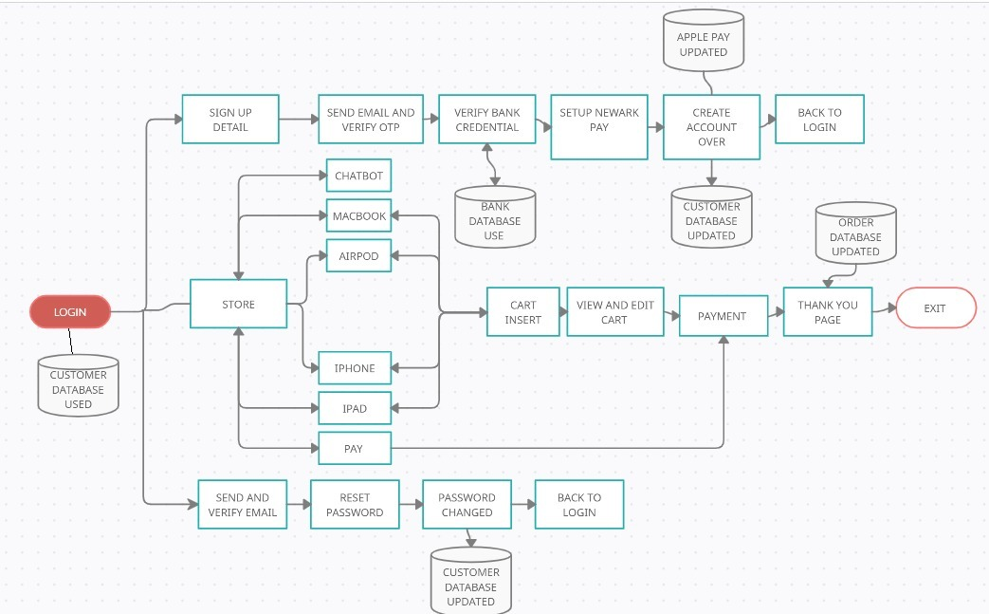

Slide 13

FEATURES

Slide 14

Account Handling:
Our program is able to create an account for both accessing the account and generating in house payment account, login in an account by verify necessary credentials like password and forgot password.
Our primary verification is done through email:
We use email for:
Verifying email during creating an account by sending a OTP through email.
Authenticate the user when there is forget password request for a account.

Slide 15
Cart system:
A simple easy-to-use GUI for user to select items to add to shopping cart.
The user can even remove the item once they added to the cart and simultaneous updating of final price.
Chatbot:
A simple chatbot to respond to simple queries from the users.

Slide 16
Payment gateway:
We have a created a inhouse gateway where the user only need to verify his bank credential once and then he can create a id and password which he can use during checkout making the process easier for user every time he makes purchase.

Slide 17

RESULT

Slide 18
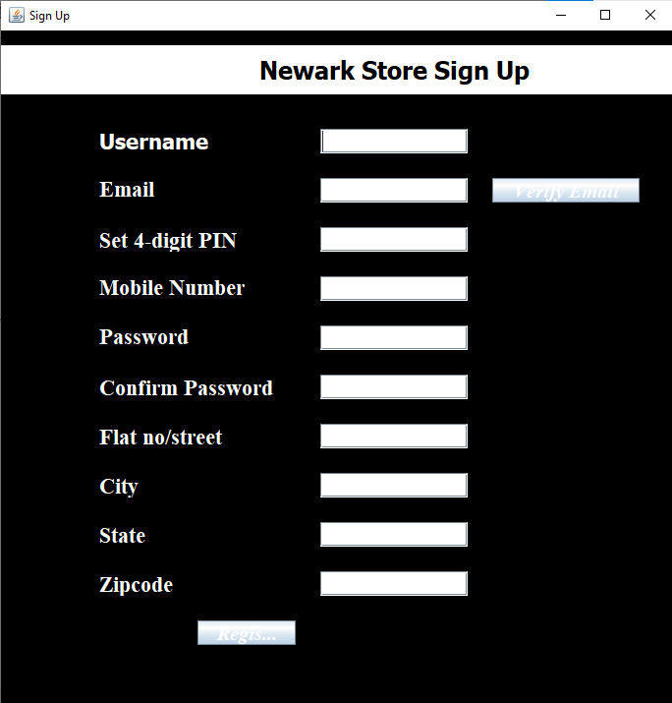
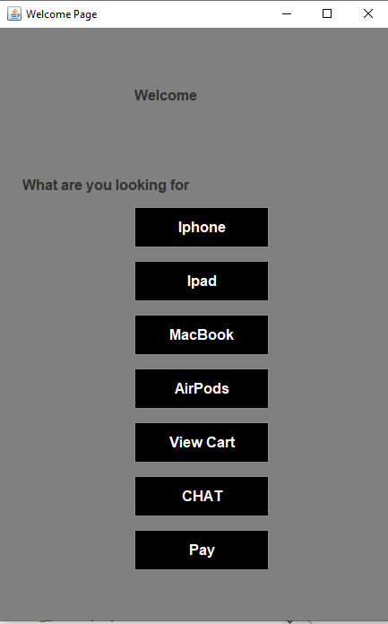

Slide 19
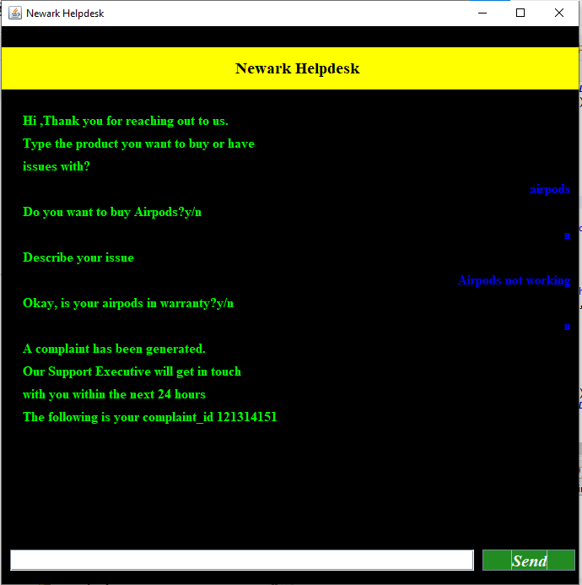
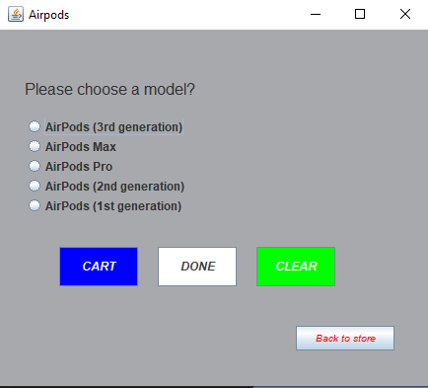

Slide 20
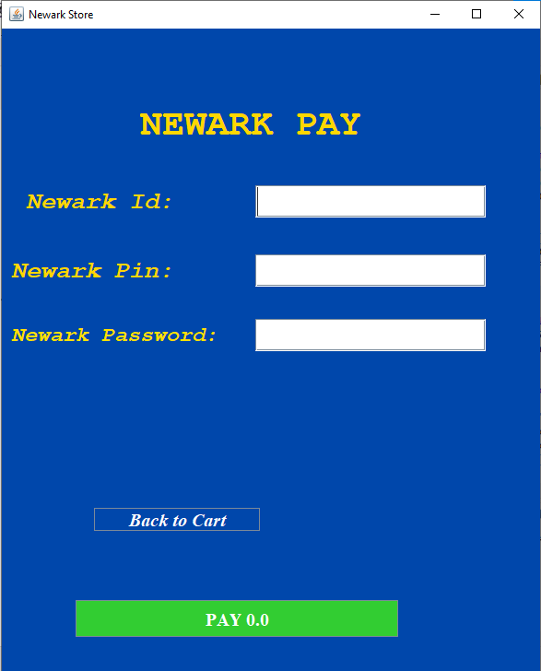
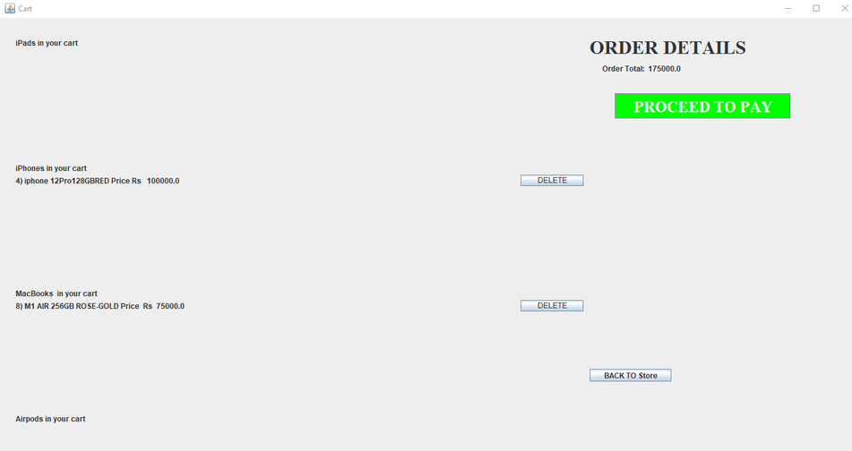

Slide 21

CONCLUSION
&
FUTURE SCOPE

Slide 22

We have successfully created an online shopping store which can be distributed to small vendors to employ it for their use.
Our future endeavors include : Ordering more than 4 items of a particular product auto-updating inventory verifying phone number

Slide 23


REFERENCES

Slide 24
https://stackoverflow.com
https://www.google.com/
https://www.youtube.com/
https://www.udemy.com/

